Slide 1
Structured Programming CSE 103
Professor Dr. Mohammad Abu Yousuf

Slide 2
RECURSION
Recursion is a process by which a function calls itself repeatedly, until some specified condition has been satisfied.

Slide 3
Factorial of an integer
#include <stdio.h>
int fact (int);
int main()
{
int n,f;
printf("Enter the number whose factorial you want to calculate?");
scanf("%d",&n);
f = fact(n);
printf("factorial = %d",f);
}
int fact(int n)
{
if (n==0)
return 0;
else if ( n == 1)
return 1;
else
return n*fact(n-1);
}
Output:
Enter the number whose factorial you want to calculate?5
factorial = 120

Slide 4
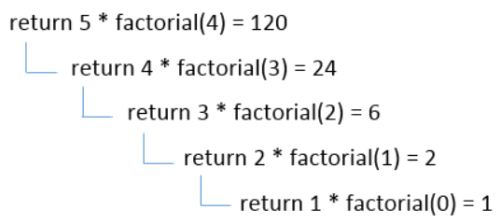
Factorial of an integer
1*2*3*4*5 = 120

Slide 5
#include<stdio.h>
int fibonacci(int);
void main ()
{
int n,f;
printf("Enter the value of n?");
scanf("%d",&n);
f = fibonacci(n);
printf(“Output is : %d",f);
}
int fibonacci (int n)
{
if (n==0)
{
return 0;
}
else if (n == 1)
{
return 1;
}
else
{
return fibonacci(n-1)+fibonacci(n-2);
}
}
Find the nth term of the Fibonacci series
Enter the value of n?
12
Output is: 144

Slide 6
Program to find power of any number
#include <stdio.h>
int main()
{
int base, exponent; long long power = 1; int i; printf("Enter base: ");
scanf("%d", &base);
printf("Enter exponent: ");
scanf("%d", &exponent); /* Multiply base, exponent times*/
for(i=1; i<=exponent; i++) {
power = power * base; }
printf("%d ^ %d = %lld", base, exponent, power);
return 0;
}

Slide 7
Program to find power of a number using recursion
#include <stdio.h> /* Power function declaration */ double pow(double base, int expo);
int main() {
double base, power; int expo; /* Input from user */
printf("Enter base: ");
scanf("%lf", &base);
printf("Enter exponent: ");
scanf("%d", &expo);
// Call pow function
power = pow(base, expo);
printf("%.2lf ^ %d = %f", base, expo, power);
return 0;
}
/** * Calculate power of any number. * Returns base ^ expo */
double pow(double base, int expo) { /* Base condition */
if(expo == 0)
return 1;
else if(expo > 0)
return base * pow(base, expo - 1);
else
return 1 / pow(base, -expo);
}

Slide 8
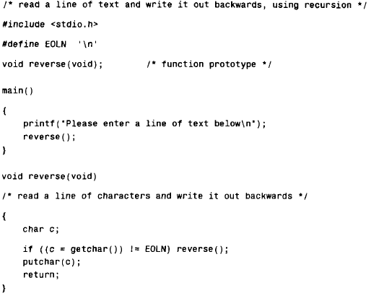

Slide 9
Output:
Now is the time for all good men to come to the aid of their country!
!yrtnuoc r i e h t fo dia eht ot emoc ot nem doog lla rof emit eht si woN

Slide 10
The Towers of Hanoi :
The Towers of Hanoi is a well-known children's game, played with three poles and a number of different-sized disks. Each disk has a hole in the center, allowing it to be stacked around any of the poles. Initially, the disks are stacked on the leftmost pole in the order of decreasing size, i.e., the largest on the bottom and the smallest on the top.
The object of the game is to transfer the disks from the leftmost pole to the rightmost pole, without ever placing a larger disk on top of a smaller disk. Only one disk may be moved at a time, and each disk must always be placed around one of the poles.

Slide 11
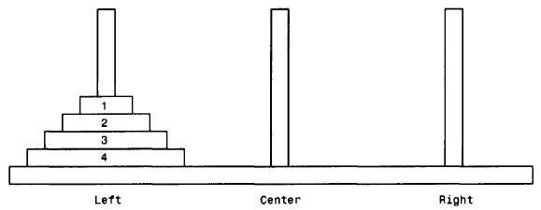

Slide 12
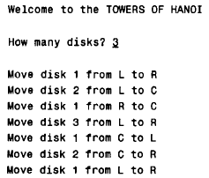
For the case where n =3, the following output is obtained

Slide 13
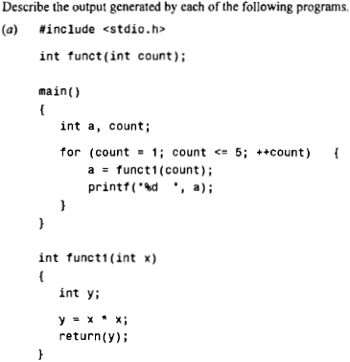
Find output

Slide 14
Find output
Output of previous program: 1 4 9 16 25

Slide 15
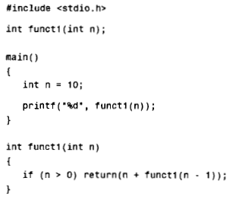
Find output

Slide 16
Find output
Output of previous program : 55

Slide 17
Global and local variables
A local variable is a variable that is declared inside a function. A global variable is a variable that is declared outside all functions.
A local variable can only be used in the function where it is declared. A global variable can be used in all functions.

Slide 18
Global and local variables
void function1(){
int x=10;//local variable
}
int value=20;//global variable
void function1(){
int x=10;//local variable
}

Slide 19
#include<stdio.h>
// Global variables
int a;
int b;
int Add()
{
return a + b;
}
int Mul()
{
int c=10; //Local Variable
int d=20; ////Local Variable
return c*d;
}
void main()
{
int Ans1, Ans2, c=30;// Local variable
a = 50;
b = 70;
Ans1 = Add();
Ans2= Mul();
printf("The addition result is: %d\n",Ans1);
printf("The Multiplication result is: %d\n",Ans2);
printf("%d\n", c);
}
Output:
The addition result is: 120
The Multiplication result is: 200
30

Slide 20
Thank You

